Slide 1
District 02 • SENECA county • JULY 2021
Notes:
Welcome and intro

Slide 2
Commissioners Meeting
Patrick McColley, P.E., S.I. Deputy Director
Mark Bressler, Highway Management Administrator
Bryan Spero, Transportation Manager
Brian French, P.E., Area Engineer
Jeff Loehrke, Regional Manager, Division of Jobs & Commerce

Slide 3
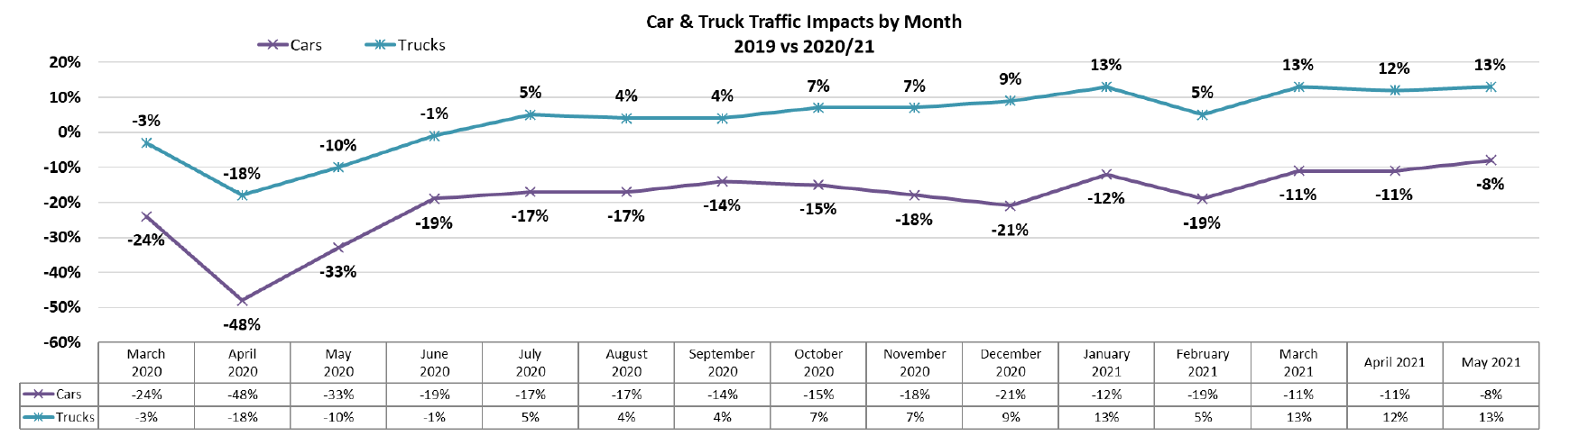
Traffic Volumes

Slide 4
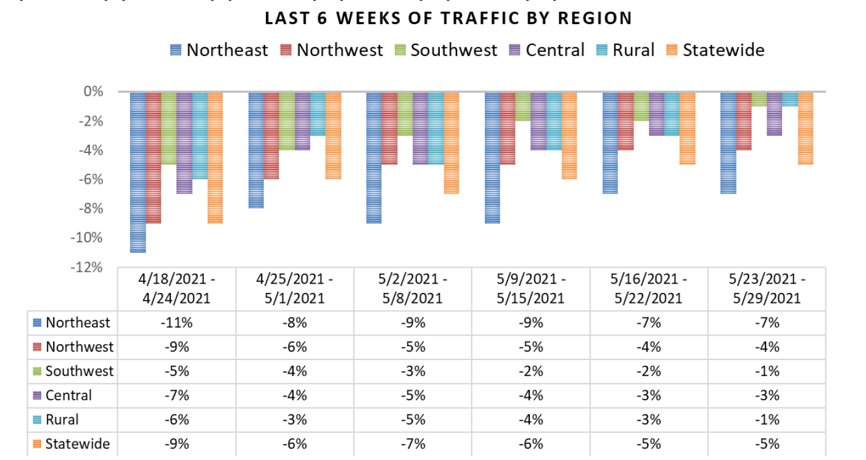
Traffic Volumes

Slide 5
Traffic Volumes

Slide 6
Projected receipts based on consumption
 | Original Budget | Rev1227,498,545 ted Receipts (-30% through June, -10% thereafter) | Projected Actual Reduction | Projected Actual | Difference (Revised to Actual)
March ‘20 | $ 141,925,148 | $ 94,557,082 | 14% | $ 128,781,552 | $ 27,498,545
April | $ 154,849,015 | $ 107,781,797 | 33% | $ 103,748,840 | $ 12,786,490
May | $ 165,162,037 | $ 115,344,316 | 27% | $ 120,568,287 | $ 5,223,971
June | $ 143,090,613 | $ 95,511,883 | 10% | $ 128,781,552 | $ 33,269,669
July | $ 131,429,593 | $ 118,286,634 | 7% | $ 121,835,233 | $ 3,548,599
August | $ 137,448,244 | $ 123,703,420 | 10% | $ 123,703,420
September | $ 115,021,321 | $ 103,519,189 | 5% | $ 108,695,148 | $ 5,175,959

Slide 7
Projected receipts based on consumption
 | Original Budget | Revised Projected Receipts (10% Down) | Projected Actual Reduction | Projected Actual | Difference
October | $ 132,061,273 | $ 118,855,146 | 7% | $ 122,420,800 | $ 3,565,654
November | $ 124,326,662 | $ 111,893,996 | 9% | $ 113,012,936 | $ 1,118,940
December | $ 112,725,026 | $ 101,452,523 | 8% | $ 103,481,573 | $ 2,029,050
January ‘21 | $ 145,757,900 | $ 131,182,110 | 10% | $ 131,182,110
February | $ 139,582,098 | $ 125,623,889 | 11% | $ 124,367,650 | $ 1,256,239
March | $ 143,887,781 | $ 129,499,003 | 6% | $ 137,268,943 | $ 7,769,940
Sum | $ 1,787,266,711 |  |  | $1,567,848,044 | $ 219,418,667

Slide 8
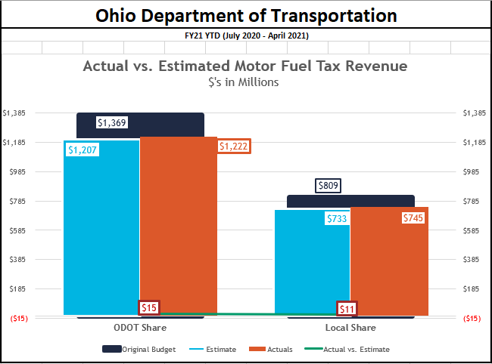
Local vs state

Slide 9
Safety
Injuries
Fatalities
Notes:
Overall, travel in Ohio traffic was down about 15 percent last year compared to 2019 volumes. Unfortunately, traffic deaths did not decline with traffic volumes, they actually rose 7 percent. Ohio ended the year with approximately 1,238 traffic deaths - 83 more deaths than the 1,155 reported in 2019.
Traffic deaths in Ohio have risen six of the past seven years despite safer vehicle technology.
However, serious injuries declined for the fourth straight year. There are currently 7,154 reported serious injuries in 2020 compared to 7,487 last year.
We suspect serious injuries in Ohio have been trending down because more people are driving newer, safer vehicles that reduce the severity of injuries in a crash.
We suspect fatalities have gotten worse because these safety features are less effective when drivers engage in the most dangerous activities such as extreme speeds, not wearing a seat belt, distracted driving or are severely impaired by drugs and alcohol.

Slide 10

Safety
Pedestrian Fatalities
+29%
Intersection
Fatalities
+33%
Motorcycle Fatalities
+23%
Notes:
These behaviors are likely contributing to some other disturbing trends over the last year.
Traffic deaths involving pedestrians were up 29 percent. Fatalities at intersections were up 33 percent. Fatalities involving motorcycles were up 23 percent. However, deaths involving older adults (age 65+) and Commercial Motor Vehicles were down.
So far this year – traffic deaths appear to be up again. These numbers are preliminary, but it appears that in January there were about 28 more deaths than the same time last year. There are many factors that go into a month-to-month spike in fatalities, including weather conditions, but this is certainly an undesirable trend for the state.
Driving at extreme speeds, not wearing a seat belt, using an electronic device while driving or driving while severely impaired by drugs and alcohol are choices drivers make. That means crashes and fatalities caused by these decisions are absolutely preventable.

Slide 11

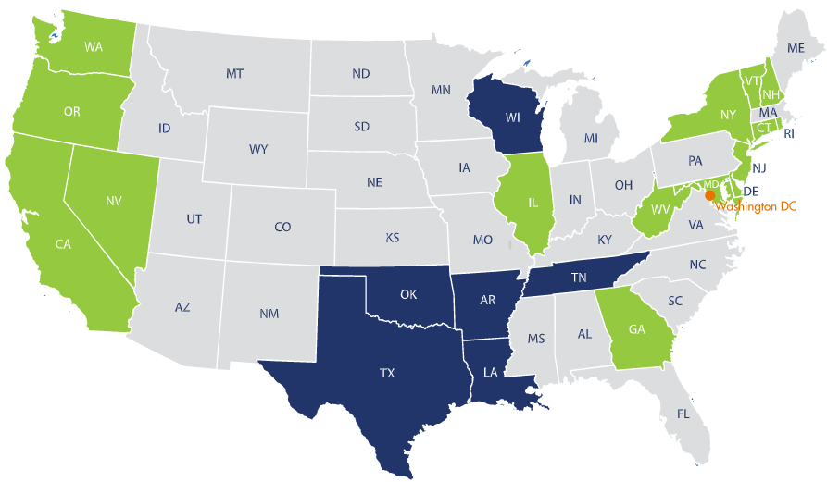

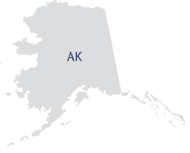

HANDS-FREE OHIO

Slide 12
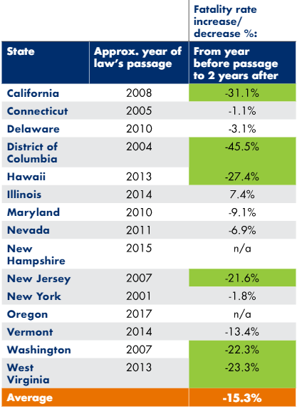
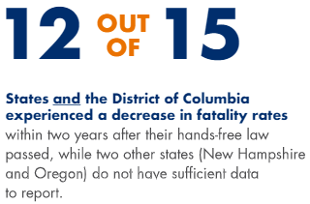
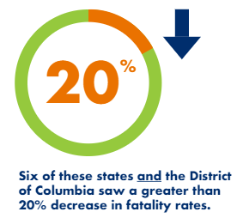
HANDS-FREE OHIO

Slide 13
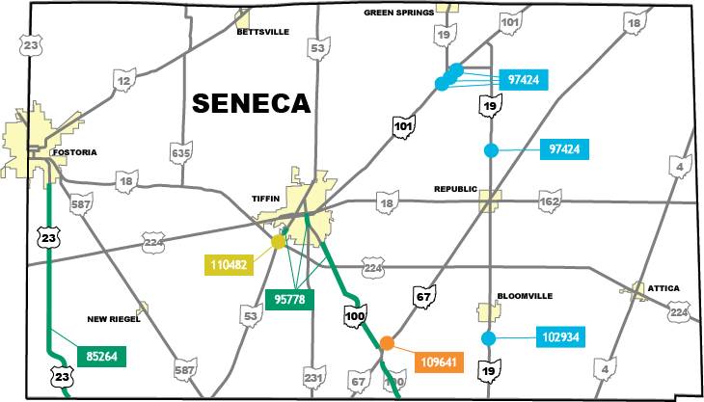




seneca county 2021 Construction Season
Notes:
Projects completed by ODOT crews are not indicated on this map

Slide 14
seneca County Construction
Active and Upcoming Projects
U.S. Route 23 Bridge Replacement & Resurfacing
  PID 85264 • $4.3 million • Bridge opened to traffic May 4 • Resurfacing ends October
U.S. 224 at State Route 53 Intersection Upgrade
  PID 110482 • $1.4 million • Begins late July • Ends October
State Route 19 Bridge Rehab
  Over Silver Creek • PID 102934 • $400,000 • Opened to traffic May 24
State Route 19 Culvert Replacements
  Republic & Lowell • PID 97424 • $1.1 million • Begins summer • Ends October
Notes:
85264: Resurface U.S. 23 between the Wyandot County line and Fostoria. Replace bridge over Wolf Creek. Lane restrictions are expected.
110482: A safety funded project to upgrade the existing signal, install eastbound and westbound left turn lanes and restripe to create positive offset for left turn lanes, southwest of Tiffin. Lane restrictions.
102934: Rehabilitate SR 19 bridge structure over Silver Creek, south of Bloomville. Opened already.
97424: Replace two culverts on SR 19: one north of Republic, and one northeast of Lowell. PID includes culvert and bridge on SR 101. Requires road closures for all.

Slide 15
seneca County Construction
Active and Upcoming Projects Continued
State Route 53 Resurfacing
  SR 53 in Tiffin • PID 95778 • $3 million • Begins August 3 • Ends October
State Route 67 Pedestrian Safety
  Install RRFB in Melmore • PID 109641 • $78,000 • Begins August • Ends October
State Route 100 Resurfacing
  Crawford Co. line to Tiffin • PID 95778 • $3 million • Begins August • Ends October
State Route 101 Bridge and Culvert Replacements
  Northeast of Lowell • PID 97424 • $1.1 million • Begins summer • Ends October
Notes:
State Route 67 Install Rectangular Rapid Flashing Beacons (RRFB) and related sidewalk and pavement improvements on SR 67 near TR 1066 in Melmore.

Slide 16
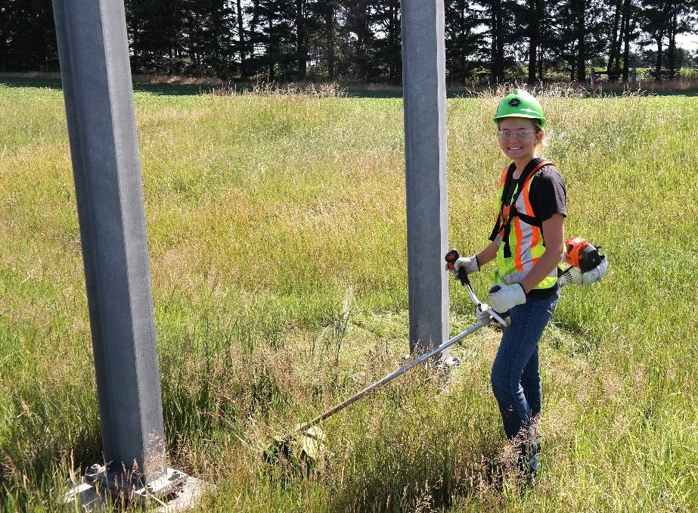
Seneca COUNTY MAINTENANCE
Daily Operations
Pavement Patching
Mowing
Vegetation Maintenance
Berm Rehabilitation
Slope protection and clean ditches

Slide 17
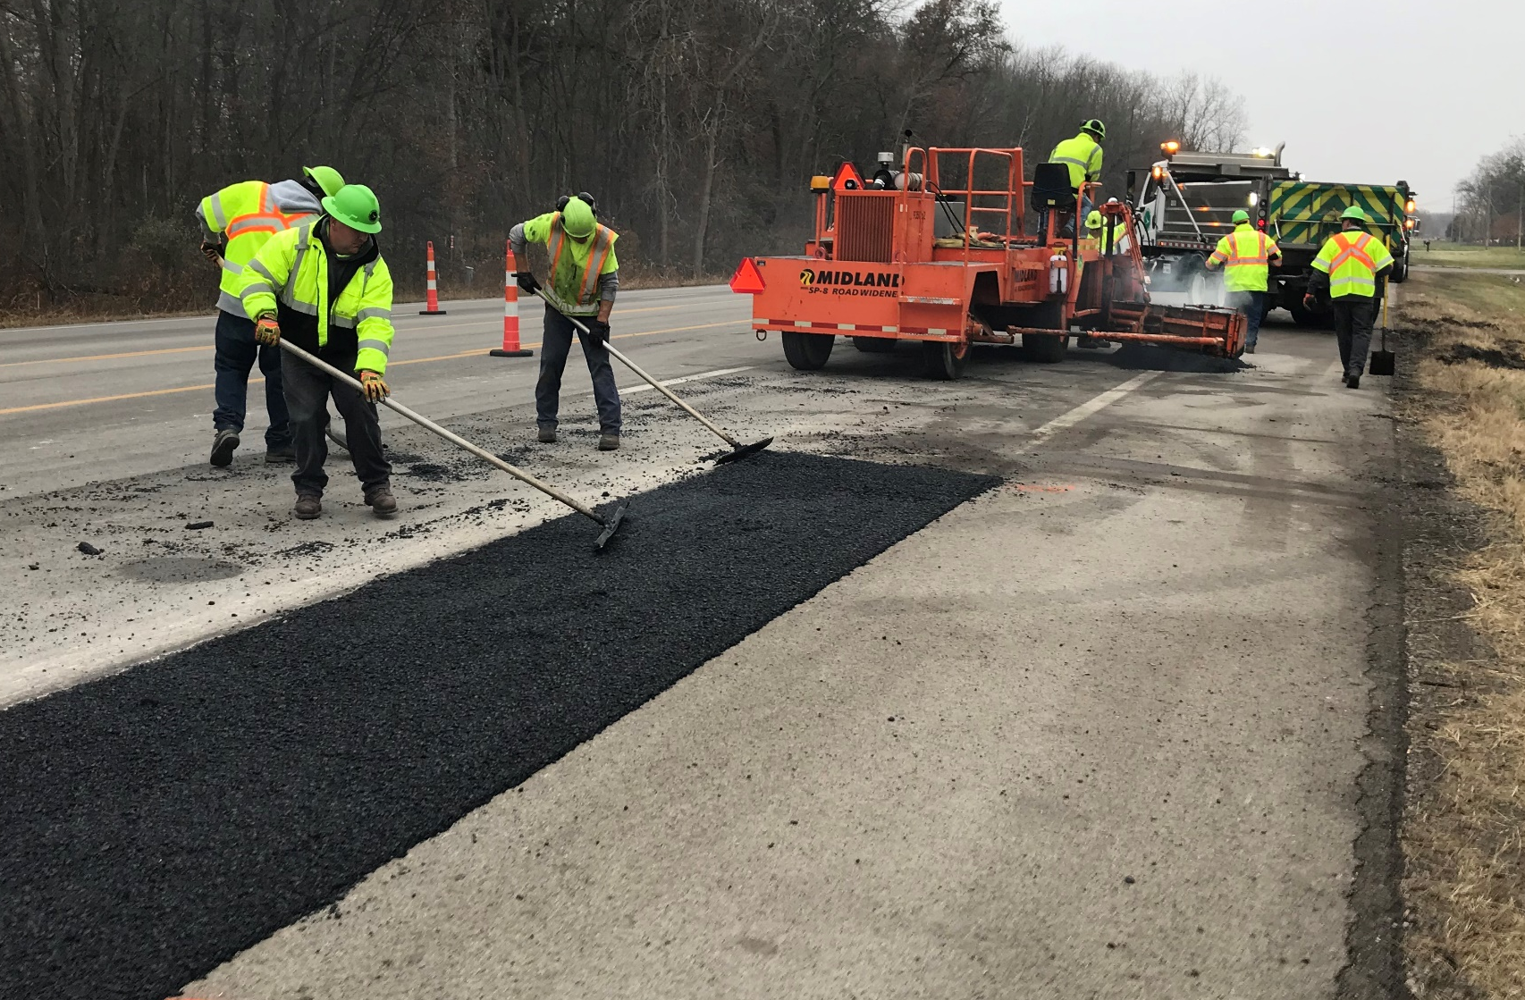
Seneca county operations
Specialized Work Crews
Bridges
Drainage
Paving Train
  Asphalt
  Chip Seal

Slide 18
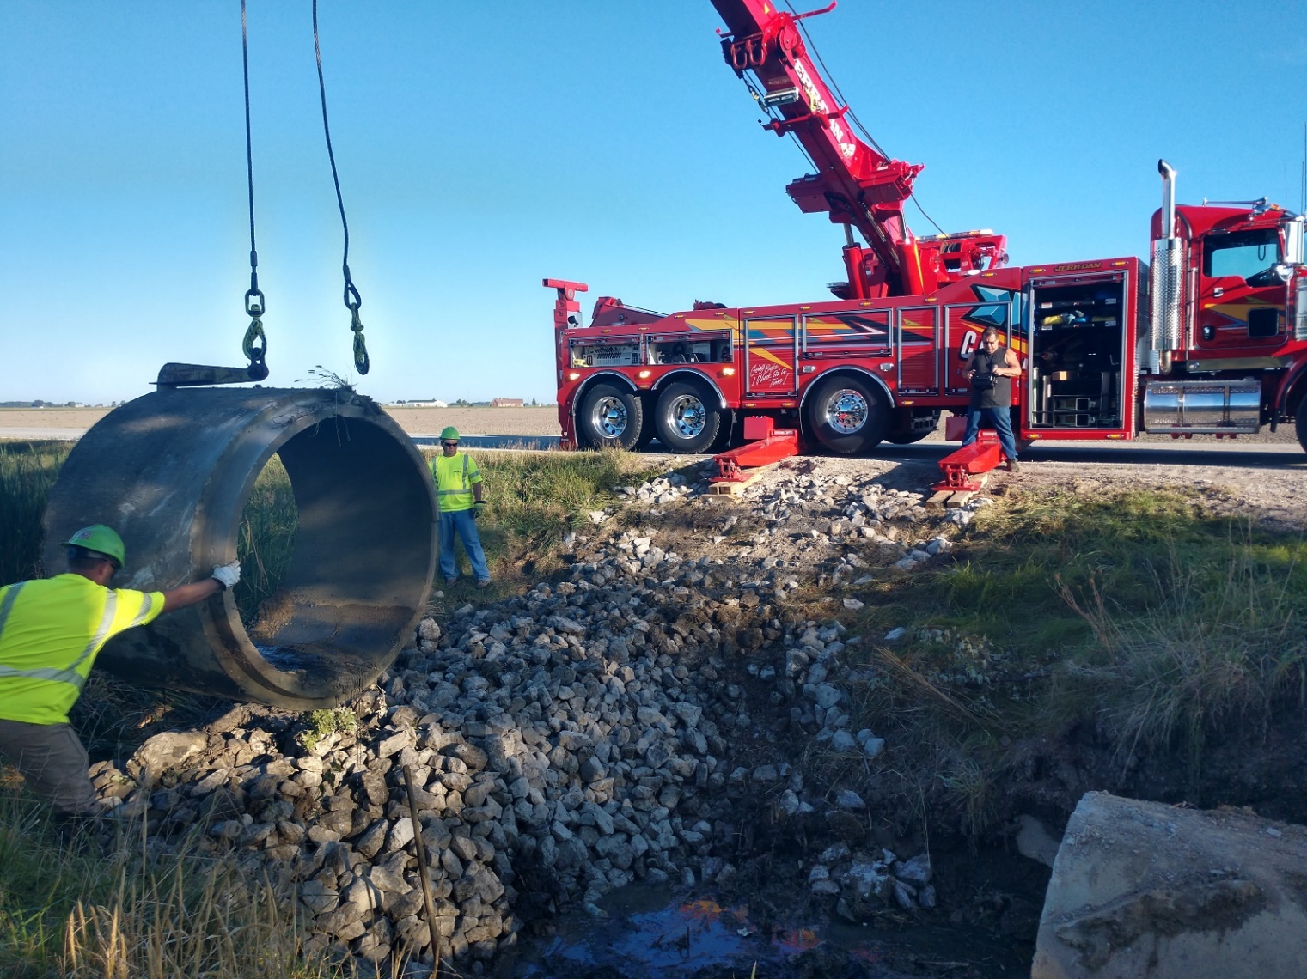
Seneca county MAINTENANCE
Culverts & Drainage
US 224 (four culverts)
SR 53 ditch drainage
SR 162 culvert
SR 231 pipe reline
SR 587 new outlet
Notes:
Culverts:
4 culverts on US 224 @ 8.27, 8.36, 8.76 and 8.85 Replace existing
SR 53 North of Ft. Seneca Replace existing pipe parallel with road for ditch drainage 1100’
SR 162 5.7mm Replace existing Consolidate 2 culverts into 1
SR 231 4mm Emergency Repair Reline pipe
SR 587 11.5mm Put new outlet in on our ROW

Slide 19

Seneca county MAINTENANCE
Paving
US 224 • SR 19 to Attica
SR 4 spot paving near Attica
SR 12 • Fostoria to Bettsville
SR 18 • Bascom to Tiffin,
And east of Tiffin to TR 159
SR 231 • Wyandot Co. to TR 90
SR 587 • Wyandot Co. to US 224
SR 590 • Bettsville to Sandusky Co.
Notes:
US 224 SR 19 to Attica
SR 4 Spots north and south of Attica
SR 12 Fostoria to Bettsville
SR 18 Bascom to Tiffin and east side of Tiffin out to TR 159
SR 231 Wyandot county line north to TR 90
SR 587 Wyandot County line to US 224
SR 590 Bettsville to Sandusky county line

Slide 20
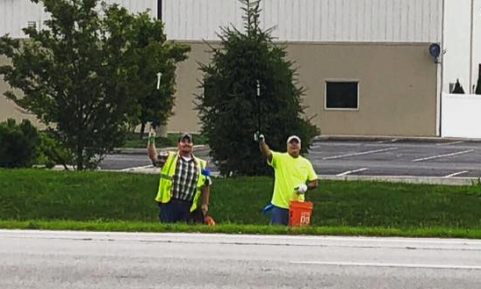
Adopt-a-highway IN Seneca COUNTY
Keeping our communities clean
New Riegel National Honor Society
Excelsior Men’s Society
Kansas United Methodist
Karen S. Pruitt
Alpha Phi Tau Men’s Fraternity
Seneca County Rising
Izaak Walton League – Tiffin/Seneca County Chapter
Bloomville Lions Club

Slide 21
JOBS & COMMERCE
In calendar year 2020, District 2 led the State:
9 Jobs & Commerce (J&C) projects
6 Transportation Improvement District (TID) projects
Totaling $2.3 million in ODOT funding
Impacts to the region:
2,503 new full time equivalent (FTE) jobs
6,695 retained FTE jobs
$1.3 billion in private capital investment
$23.6 million in roadwork improvements
Notes:
In calendar year (CY) 2020, District 2 led the State with 9 Jobs & Commerce (J&C) projects and 6 Transportation Improvement District (TID) projects totaling $2.3 million in ODOT funding
Here are the impacts to the region:
2,503 new full time equivalent (FTE) jobs
6,695 retained FTE jobs
$1.3 billion in private capital investment
$23.6 million in roadwork improvements
Highlights from CY2020:
North Star Steel (Fulton County) $700 million private capital investment…90 new FTE jobs…397 retained FTE jobs
UPS fulfillment center (Wood County) $200 million private capital investment…600 new FTE jobs
Highlights from CY2021:
There has been a steady stream of new leads coming into Ohio
Of those leads, approximately 50% have been related to the electric vehicle industry
In District 2 the office of J&C is working on 10 – 15 “Candidate” projects requiring road work improvements
Most impactful project to date: Peloton (Wood County) $400 million private capital investment…2,100 new FTE jobs
ODOT recently received 52 applications requesting $15.5 million from the TID program which has $4.5 million available
This is the first year the TID program will allow awards of up to $500,000 per project, which is double from previous years

Slide 22
JOBS & COMMERCE
Recent Highlights :
North Star Steel (Fulton County) $700 million private capital investment
  90 new FTE jobs
  397 retained FTE jobs
UPS fulfillment center (Wood County) $200 million private capital investment
  600 new FTE jobs
Steady stream of new leads coming into Ohio
  Approximately 50% have been related to the electric vehicle industry
Most impactful project to date: Peloton (Wood County) $400 million private capital investment
  2,100 new FTE jobs
First year the TID program will allow awards of up to $500,000 per project - double from previous years
Notes:
In calendar year (CY) 2020, District 2 led the State with 9 Jobs & Commerce (J&C) projects and 6 Transportation Improvement District (TID) projects totaling $2.3 million in ODOT funding
Here are the impacts to the region:
2,503 new full time equivalent (FTE) jobs
6,695 retained FTE jobs
$1.3 billion in private capital investment
$23.6 million in roadwork improvements
Highlights from CY2020:
North Star Steel (Fulton County) $700 million private capital investment…90 new FTE jobs…397 retained FTE jobs
UPS fulfillment center (Wood County) $200 million private capital investment…600 new FTE jobs
Highlights from CY2021:
There has been a steady stream of new leads coming into Ohio
Of those leads, approximately 50% have been related to the electric vehicle industry
In District 2 the office of J&C is working on 10 – 15 “Candidate” projects requiring road work improvements
Most impactful project to date: Peloton (Wood County) $400 million private capital investment…2,100 new FTE jobs
ODOT recently received 52 applications requesting $15.5 million from the TID program which has $4.5 million available
This is the first year the TID program will allow awards of up to $500,000 per project, which is double from previous years

Slide 23
Questions
?
Last updated 7/6/2021

